Slide 1
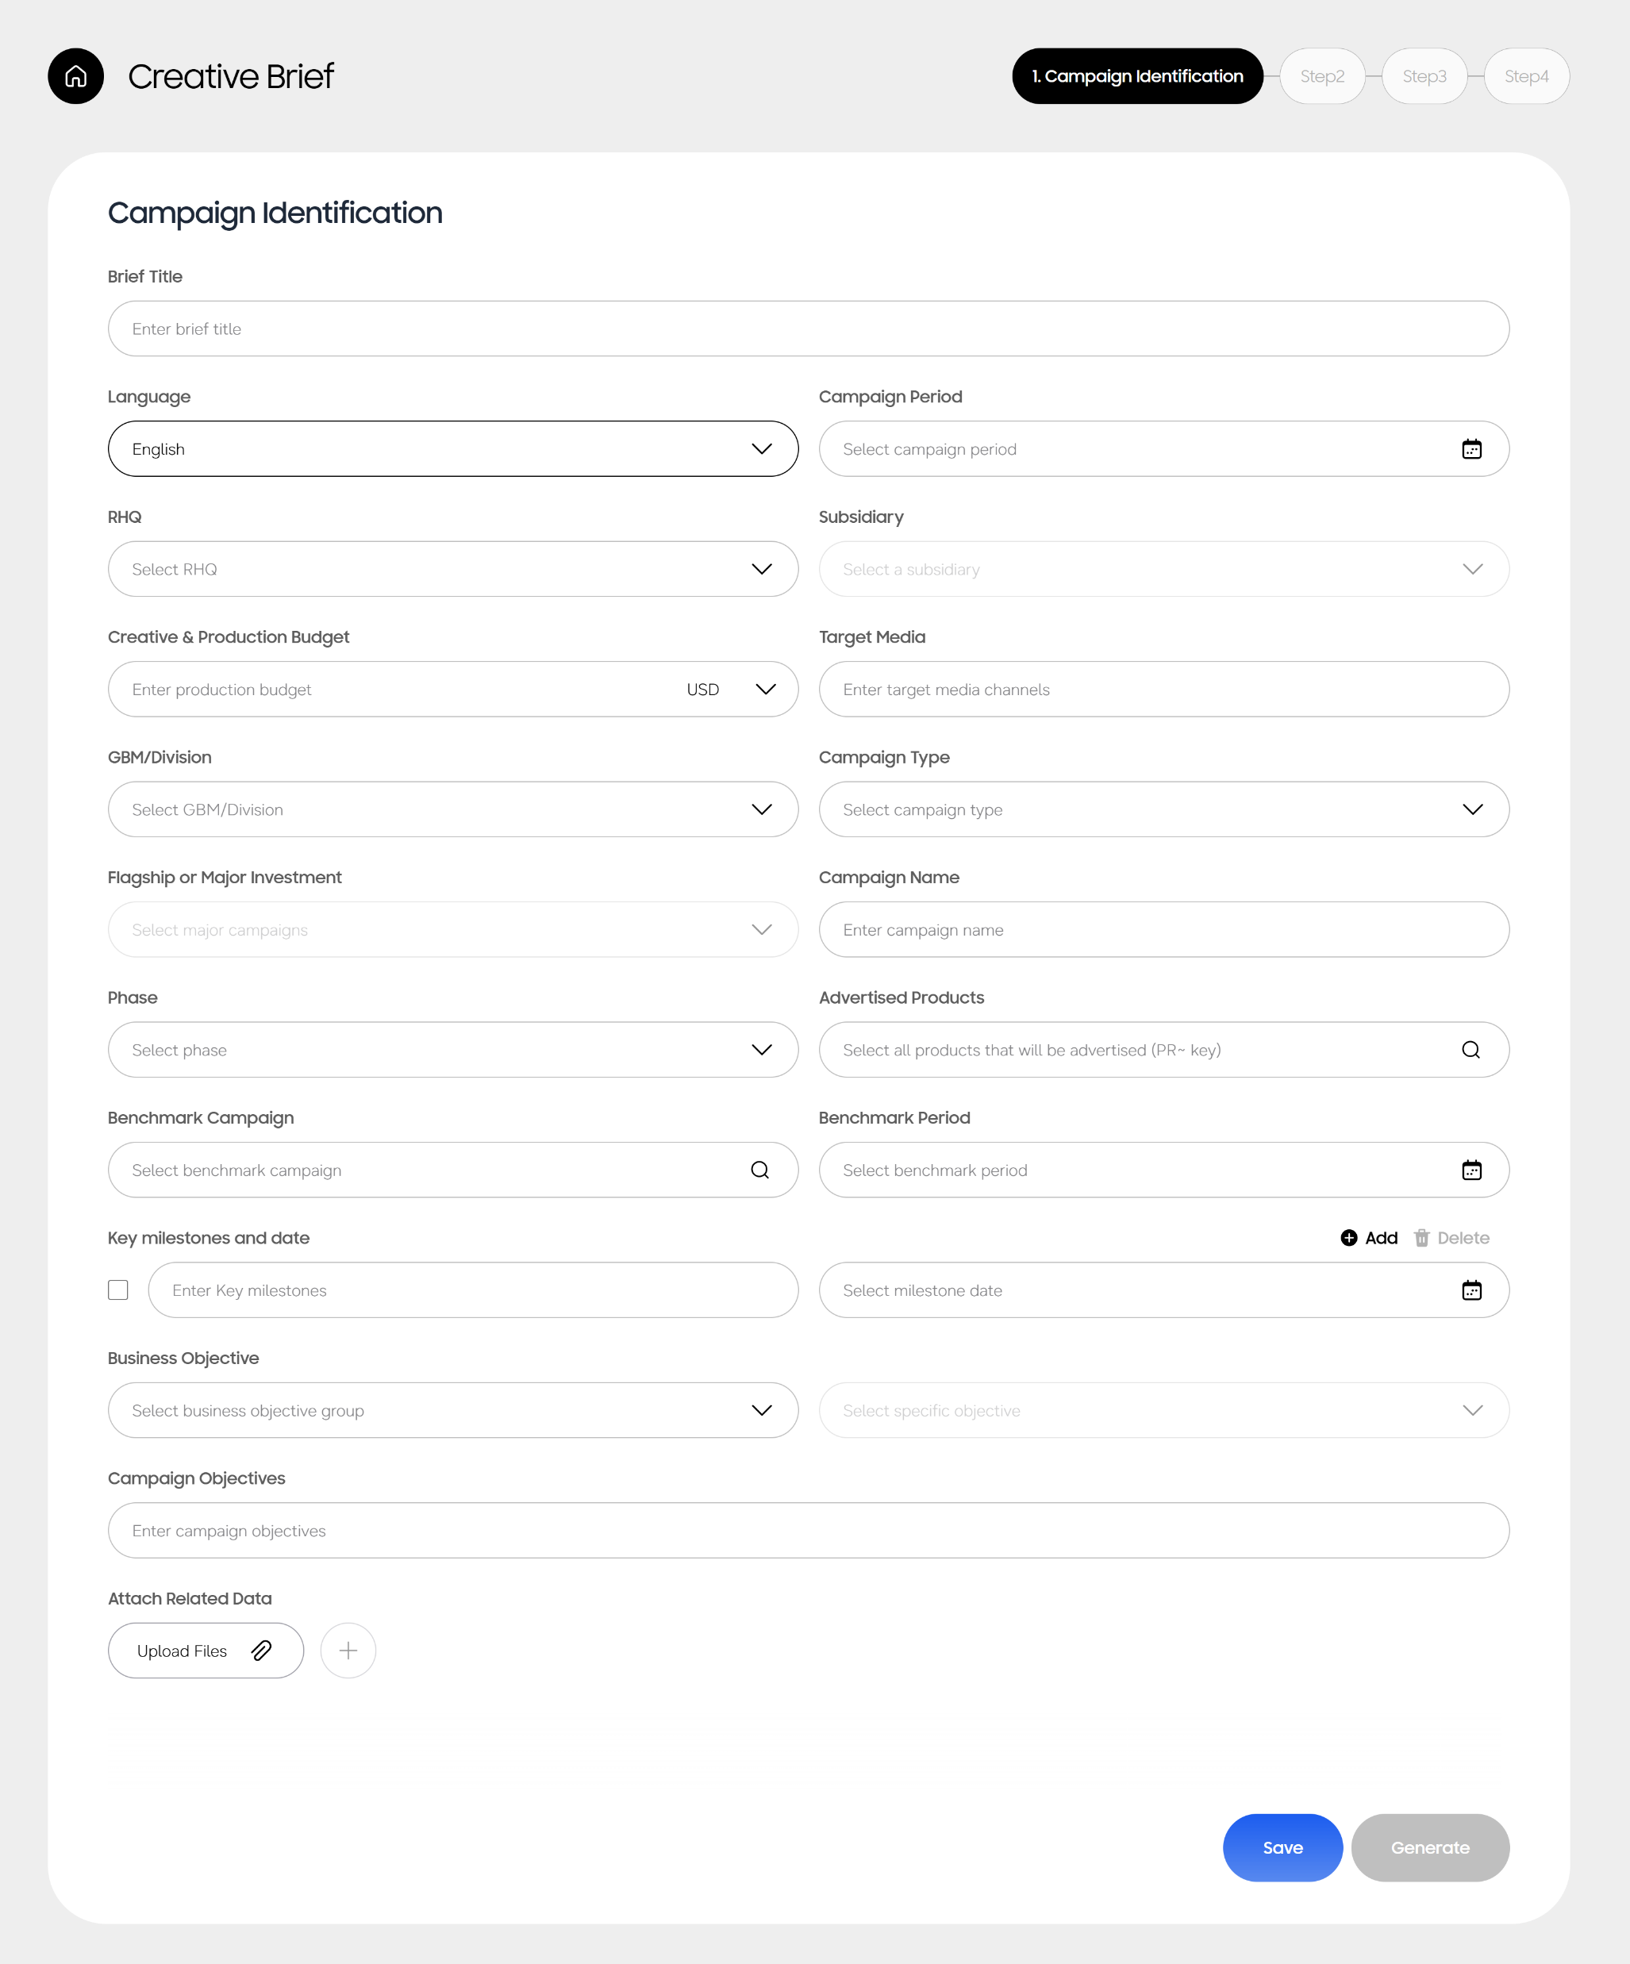
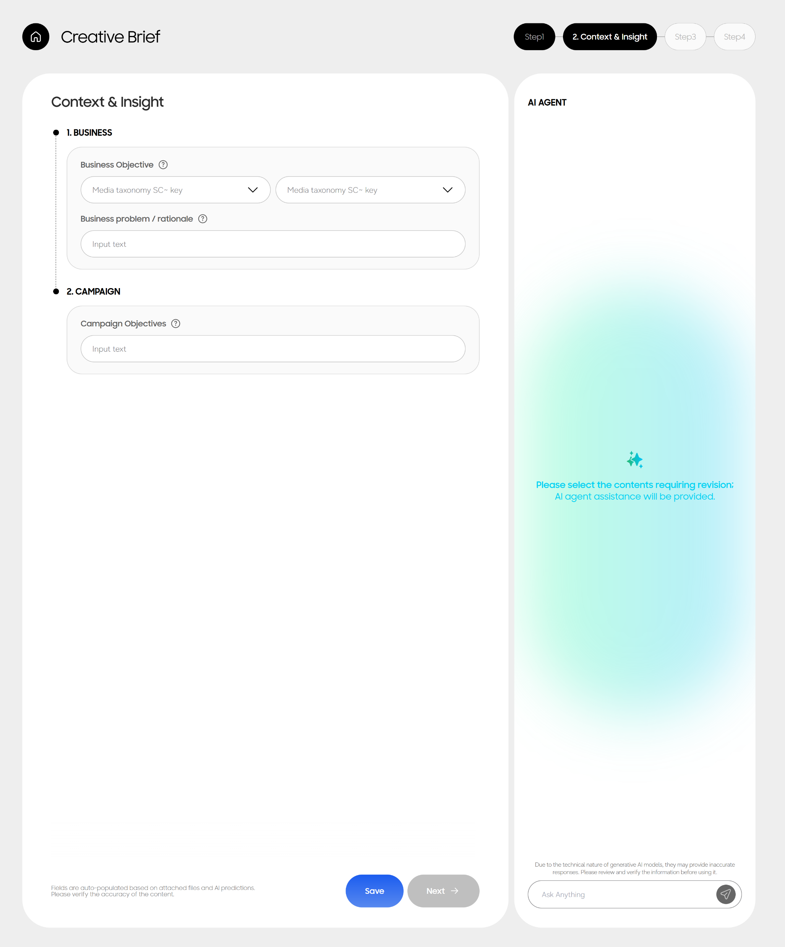
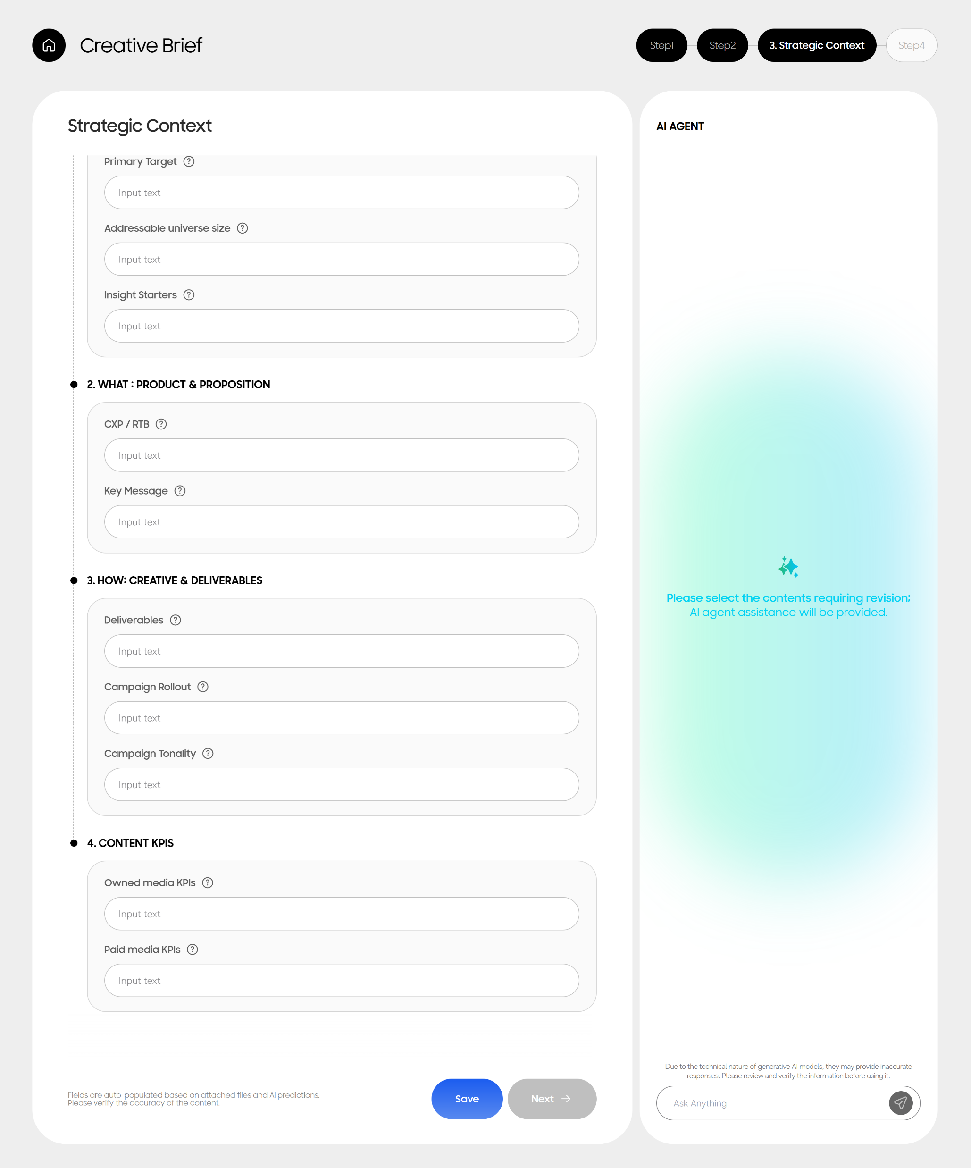
Creative Brief Agent
AI-assisted structuring that raises and standardizes the strategic quality of creative brief
[User input]
[AI-drafted, User-refined]
[AI-drafted, User-refined]
Step1. Campaign Identification
Step2. Context & Insight
Step3. Strategic Context
• Campaign requirements (region, budget, period, etc.)
• Business objective
• Who: Primary target, Insight starters, etc.
• Key milestones and date
• Business problem/rationale
• What: CXP/RTB, Key message
• Attach related data
• Campaign Objectives
• How: Deliverables, Campaign rollout, Campaign tonality
• Content KPIs
Notes:
Collaborating with Global CX Academy, developed comprehensive training programs that enable rapid adoption of AI Agent/Tool capabilities across our marketing organization.

Slide 2
Creative Brief Agent Roadmap
MVP development in Jul; selective pilot & usability validation in Aug; training rollout in Sep.
- Aug: Alpha Test – GBC/RHQ/Division Marketing
- Sep: Samsung U e-learning & Agent official launch
Creative Brief Agent Project Timeline
7/29
~8/5
8/7
8/7~14
9/1
9/15
Beta test
volunteer sign-up
Beta test
volunteer selection
Beta Test
Content Brief
Agent open
MVP development complete
Samsung U
e-learning launch
* Call for participants: Reginal creative marketing brief agent pilot (Apply via email : ax.marketing@samsung.com )
Notes:
Collaborating with Global CX Academy, developed comprehensive training programs that enable rapid adoption of AI Agent/Tool capabilities across our marketing organization.

